Slide 1
TREE DATA STRUCTURE Presented by :
NJIMKOH BEKLINE(group leader)
FUNWIE BLAISE
PENN RYAN

Slide 2
Basic Tree Terminology
Node: A fundamental unit in a tree that holds data and may have zero or more child nodes.
Root: The topmost node in a tree, serving as the starting point for traversing the tree.
Parent and Child: Nodes in a tree have relationships where one node is the parent of another, and the connected node is its child.
Leaf: A node with no children, representing the endpoints of a branch in the tree.
Siblings: Nodes that share the same parent are called siblings.
Depth: The level or depth of a node is the length of the path from the root to that node.
Height: The height of a tree is the length of the longest path from the root to a leaf.

Slide 3
TREE DATA STRUCTURES
What is Tree Data Structure?
A tree is a type of data structure that represents a hierarchical relationship between data elements, called nodes. The top node in the tree is called the root, and the elements below the root are called child nodes. Each child node may have one or more child nodes of its own, forming a branching structure. The nodes at the bottom of the tree, which do not have any child nodes, are called leaf nodes. A tree is a non-linear data structure, meaning that elements are not stored in a linear sequence like in an array or a linked list. Instead, elements are organized in a hierarchical structure, with each element having a parent-child relationship with other elements. A tree can be represented in many ways, such as in an array or a linked list, but the most common representation is a graphical one, where each node is represented as a circle and each edge is represented as a line connecting two circles.

Slide 4
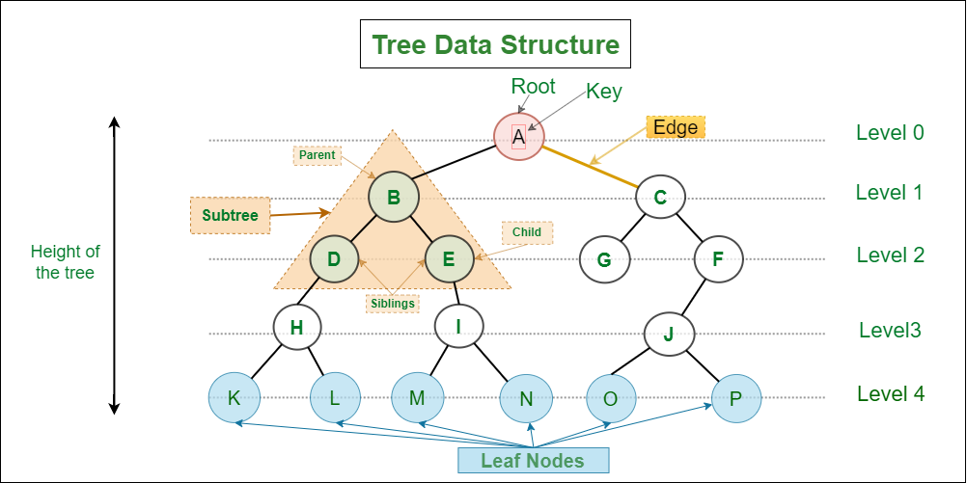

Slide 5
Applications of Tree Data Structure
To Store hierarchical data, like folder structure, organization structure, XML/HTML data.
Organization chart of a large organization..
Machine learning algorithm.
For indexing in database.
In Computer Graphics.
To evaluate an expression.
In chess game to store defense moves of player.
Tree data structures are used to organize and manage files and directories in a file system. Each file and directory is represented as a node in the tree, with parent-child relationships indicating the hierarchical structure of the file system.
Tree data structures, such as binary search trees, are commonly used to implement efficient searching and sorting algorithms.
Graphics and UI design

Slide 6
TREE TRANVERSAL ALGORITHM
DEFINITION:
This is the process by which each and every element present in a data structure is “visited” (or accessed) at least once. We will use an example on the binary tree.
1. In-order transversal:
Recursively transverse the left subtree
- Visit root node
- Recursively transverse the right subtree.

Slide 7
2. Pre-order transversal
-Visit root node
-Recursively visit the left subtree
- Recursively visit the right subtree
3. Post-order transversal :
-Transverse the left subtree
-Recursively visit the transverse right subtree
Visit root node

Slide 8
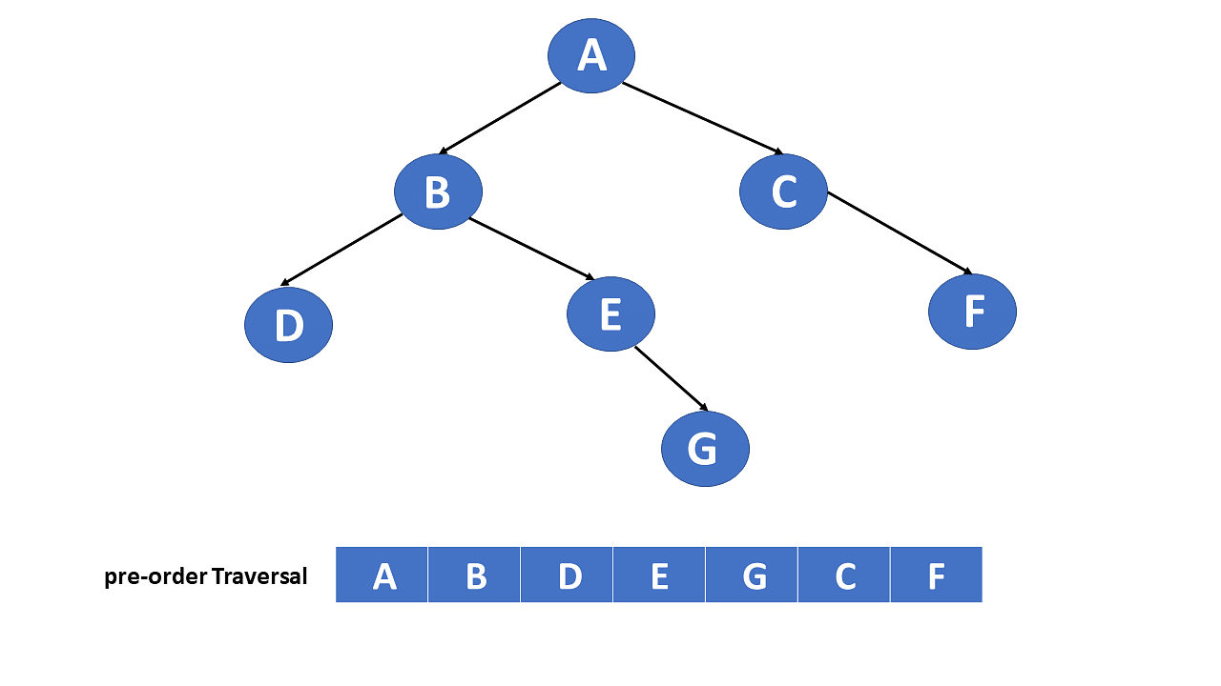

Slide 9
APPLICATION OF TREE TRANSVERSAL ALGORITHM TO REAL LIFE PROBLEM
1. Network routing
2. Epidemiology and network tracing
3. Supply chain management
4.Decision making and game theory
5. Fraud detection in financial transactions

Slide 10
ADVANTAGES OF TREE TRANSVERSAL
1.Systematic exploration: There enable systematic exploration of tree structures, ensuring every node is visited exactly once.
2.Order control: Transversal algorithm can be adapted to visit nodes in different order, such as pre-order, post-order, in-order, providing flexibility based on specific requirements.
3.Graph processing: Tree transversal algorithm are foundational for graph processing, where a tree can be viewed as a special type of graph
Understanding these advantages helps in choosing the appropriate transversal strategy based on the specific requirements of a given problem or data structure.

Slide 11
DISADVANTAGES OF TREE TRANSVERSAL
1.Not suitable for all operations: While transversal is effective for task like searching and processing, certain operations, such as finding the height of a tree or determining the lowest common ancestor, may require additional algorithms.
2. Storage overhead: Recursive implementations of transverse algorithms can consume a significant amount of stack space, especially for deep or unbalanced trees. Which might lead to a stack overflow.
3. Complexity: Understanding and implementing certain transversal algorithms, especially in a non-recursive manner, can be complex and error-prone.

Slide 12
Despite these drawbacks, tree transversal algorithms remain fundamental tools in computer science, and their disadvantages are often mitigated(reduced) through careful consideration of the specific problem an algorithm design.

